Slide 1

ESG Reporter: AI-Driven ESG Document Analysis
Mentor: Dr. P. Manasa
Team Members: Ananya Sriram, Anshita Sugandhi, P. Shriya, Deepak Jhanwar, Ansh Sugandhi

Slide 2
Project overview
ESG Reporter is an AI-powered system designed to automatically analyze financial documents and identify whether they contain Environment, Social, and Governance (ESG) related content.
The system extracts relevant ESG information using transformer-based models and generates structured insights that help organizations understand their sustainability performance.
Our work focuses on automating a process that is usually time-consuming and manually intensive, especially when analyzing lengthy reports like annual reports, CSR reports, or sustainability filings.
The project integrates document processing, ESG classification, and recommendation generation into one seamless workflow that produces a concise and actionable ESG summary.
The ultimate goal is to support companies, auditors, and analysts in improving ESG compliance and making informed decisions based on objective AI-driven insights.

Slide 3
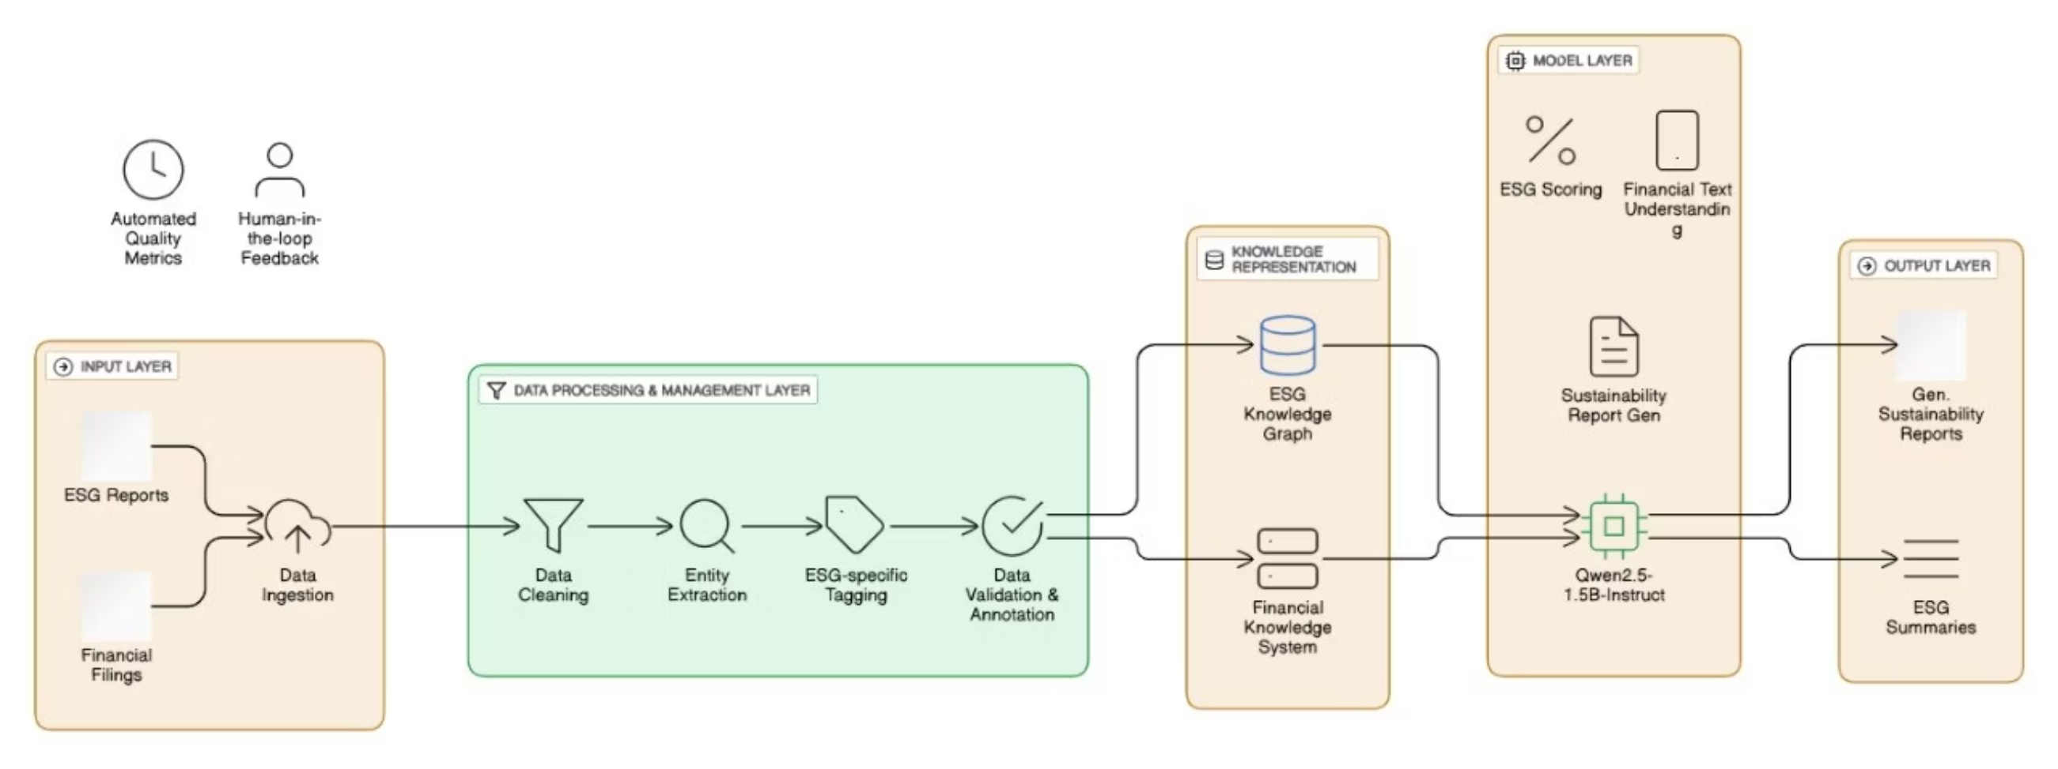
Final System Architecture
• The data moves sequentially from document ingestion → cleaning → entity extraction → ESG tagging → validation → knowledge graph storage, after which the model layer retrieves this enriched information to perform ESG scoring and generate the final sustainability rep
• The architecture integrates rule-based preprocessing, knowledge-graph enrichment, and transformer-based models—such as financial text understanding modules and Qwen2.5-1.5B-Instruct—into one unified pipeline that ensures accurate ESG analysis supported by automated quality metrics and human-in-the-loop feedback.

Slide 4
Technology Stack
I. Core languages and frameworks
II. Databases
Python 3.13 (Backend Core)
SQLite (Embedded DB for History)
React 18+ / TypeScript (Frontend UI)
SQLAlchemy (ORM) & Alembic (Migrations)
FastAPI (Async Web Framework)
Uvicorn (ASGI Server)
Tailwind CSS (Styling)
III. AI/ML Stack & Inference
IV. Development & Tools
Model: Qwen 2.5-1.5B-Instruct
IDE: VS Code / Jupyter Notebooks
Adapter: Fine-tuned fingesg4 (ESG specialization)
Version Control: Git / GitHub
Inference Engine: LM Studio
Frontend Tools: Vite, npm/pnpm
Integration: OpenAI Python Client
Security: bcrypt, HTTPOnly JWT Cookies

Slide 5

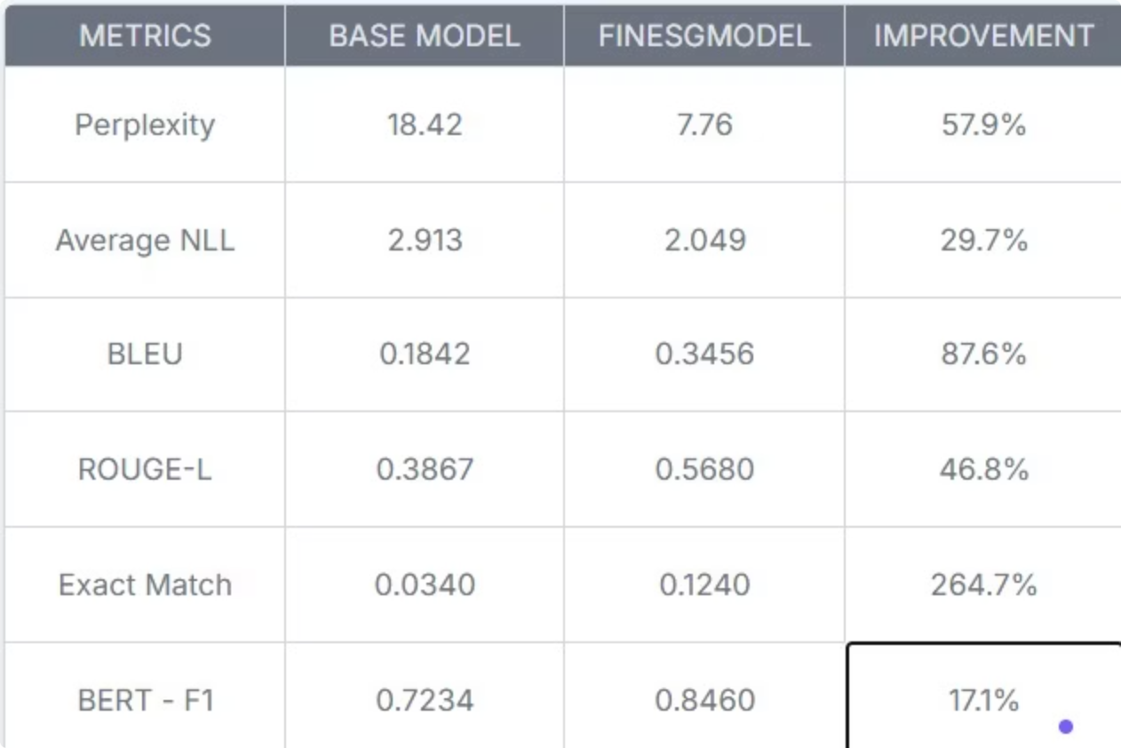
Model Performance Comparison
The fine-tuned ESG model outperforms the base model across all major evaluation metrics.
Large gains in metrics like perplexity, BLEU, and Exact Match highlight better understanding and generation.
Overall, the fine-tuned model delivers more accurate and reliable ESG insights.

Slide 6
Key Learnings
Real-World Applications
- We learned that ESG-specific fine-tuning significantly strengthens the model's understanding and accuracy.
- The system can help companies quickly analyze ESG risks, compliance issues, and sustainability scores.
- Building the full pipeline gave us deeper insight into model integration, preprocessing, and API communication.
- Financial analysts can use it to interpret lengthy ESG documents more efficiently and make informed decisions.

Slide 7
Challenges Faced
Limitations We Overcame
- Handling different PDF formats and ensuring consistent text extraction was technically challenging.
- Improved our model's performance by optimizing it within the limited computational resources available.
- Model integration with LM Studio and maintaining stable inference performance required considerable tuning.
- Ensured strong model performance even without access to extremely large models.

Slide 8
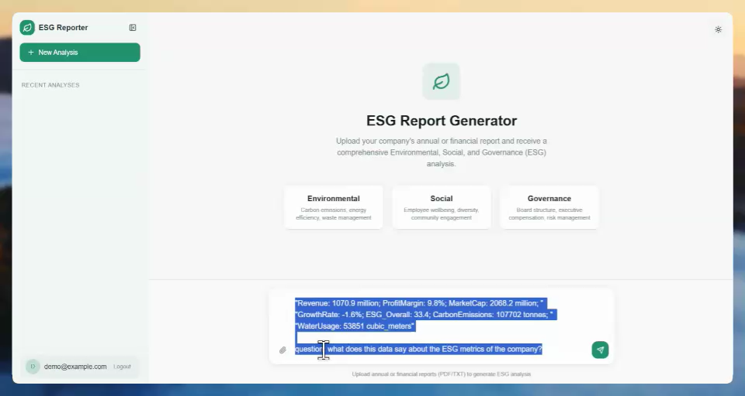


Slide 9
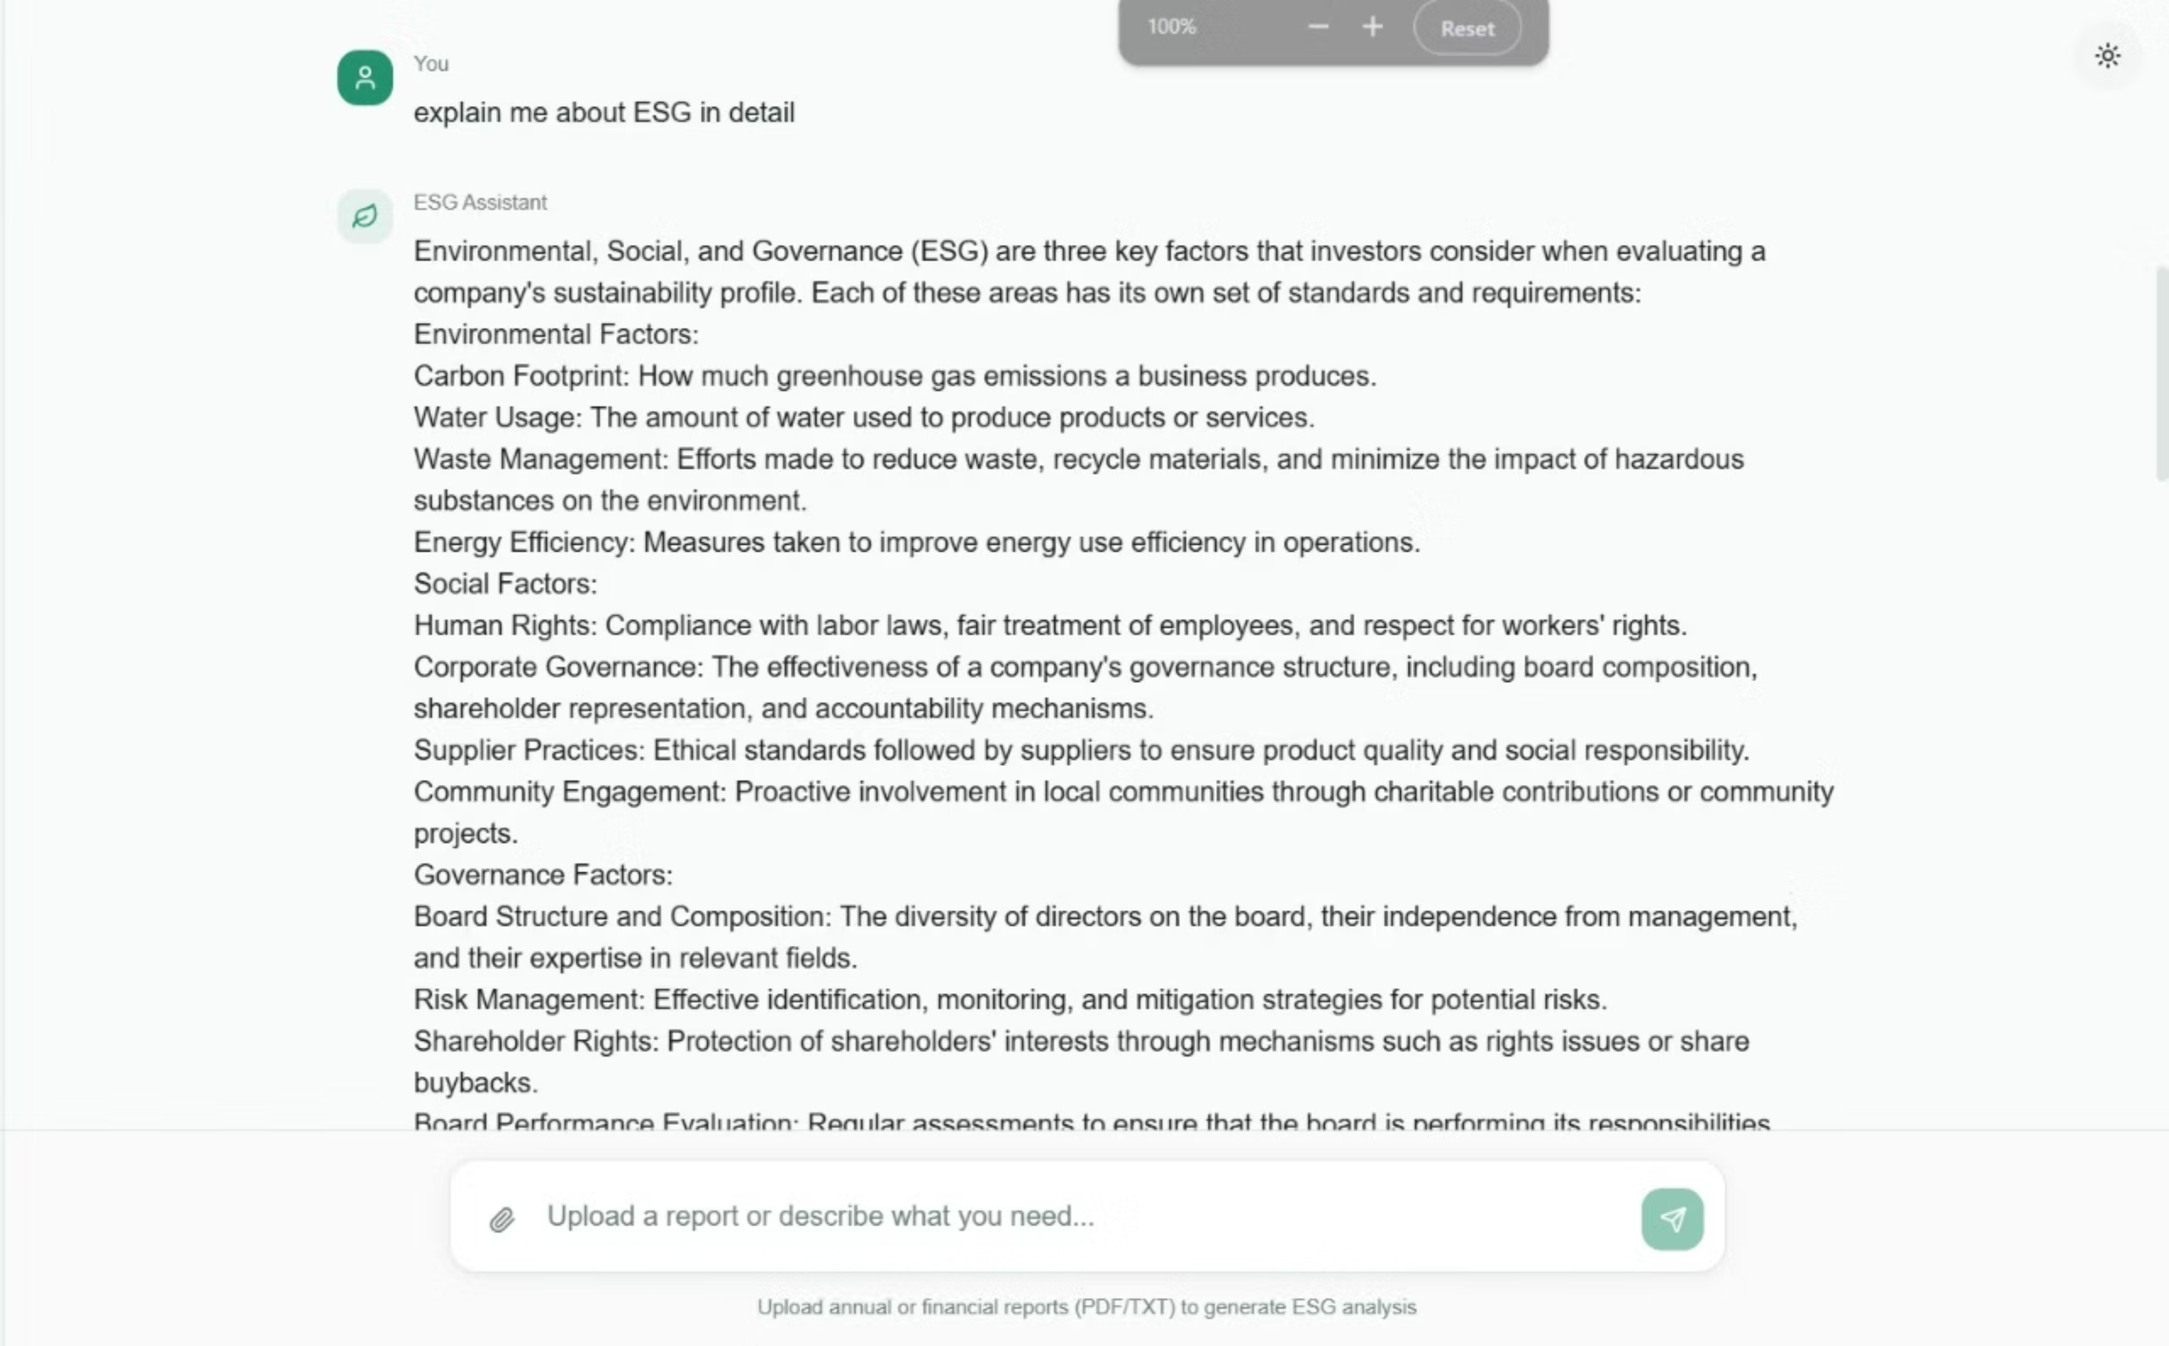


Slide 10
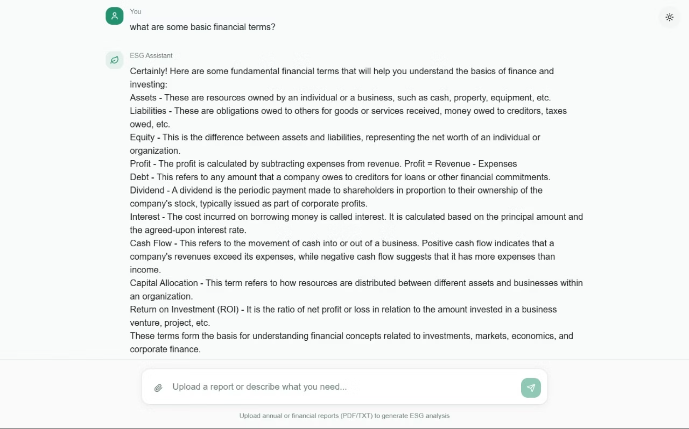

Slide 11
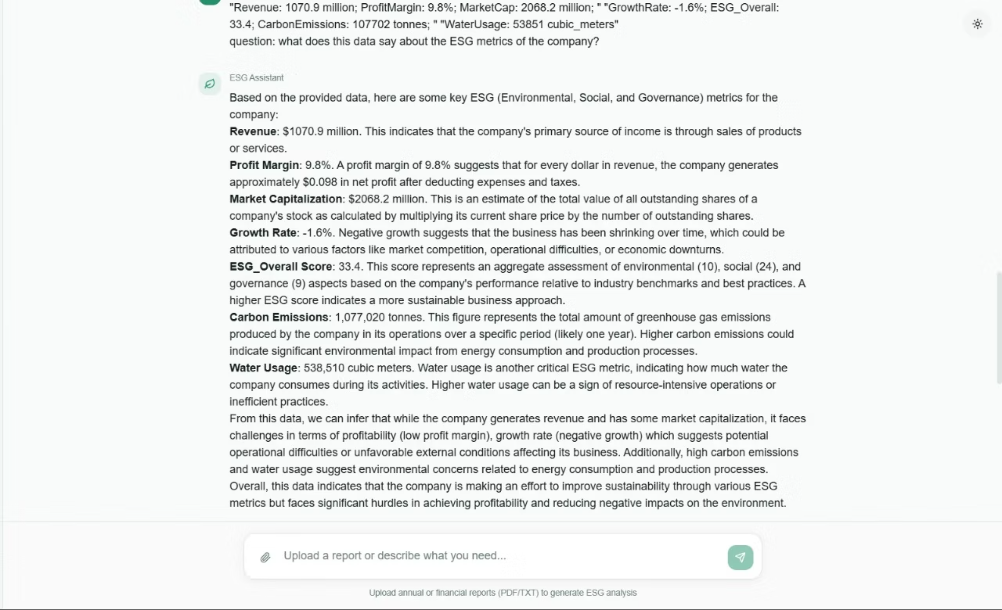
The screenshots illustrate how the system responds intelligently to user queries, demonstrating its core capability to analyze, interpret, and generate meaningful insights from ESG-related information.

Slide 12

Thank You!

